Slide 1

CSE299.1 – GROUP 2 – WEEKLY UPDATE
TRAVELLER
September 21, 2020
SHAZID HASAN RIAM - 162 1060 042
SIDRATUL MUNTAHA TAJ – 173 1905 642

Slide 2
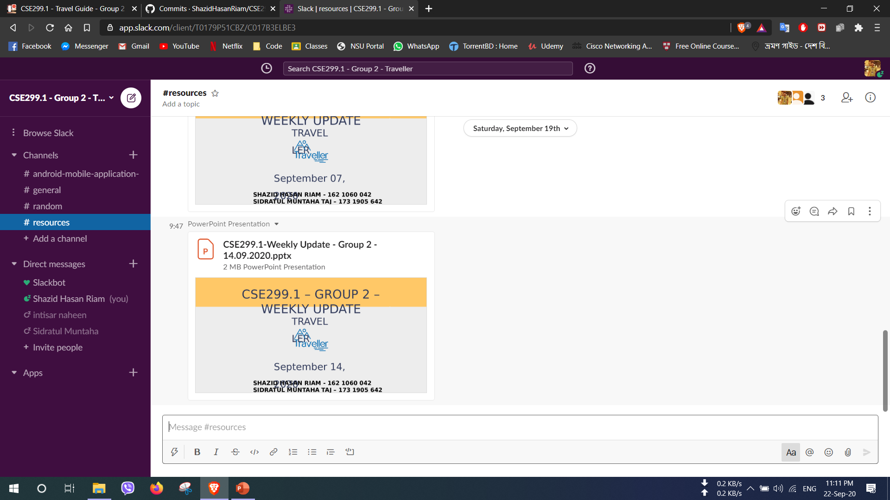
SLACK

Slide 3
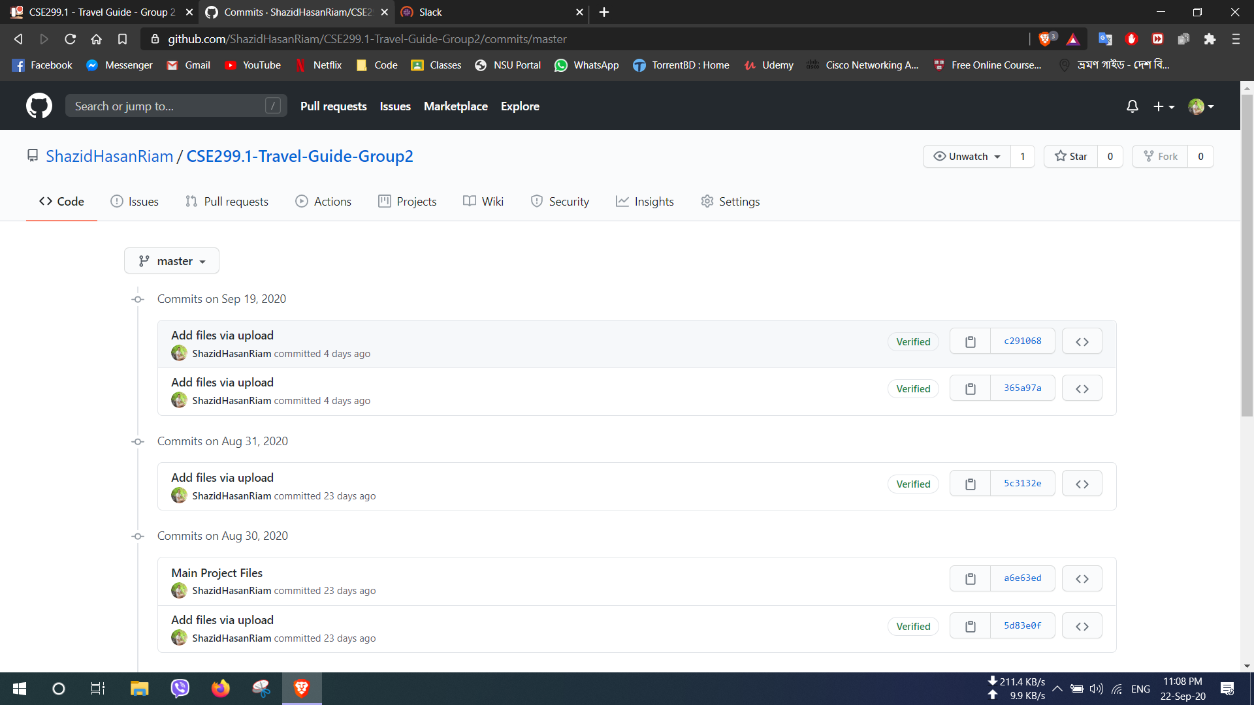
GITHUB

Slide 4
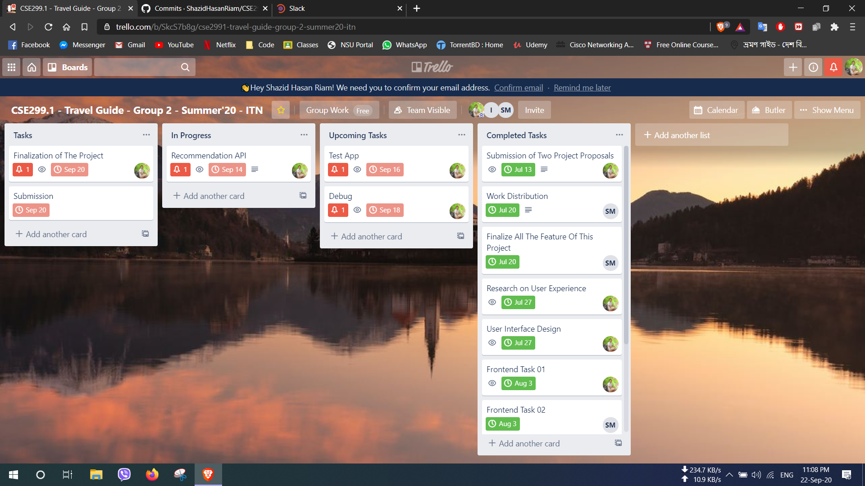
TRELLO

Slide 5
THANK YOU

